Slide 1
SCOTTS VALLEY WATER DISTRICT
2026 RATE STUDY
Board Meeting – June 11, 2026

Slide 2
Agenda
Rate study overview
Proposed rate study results
Next steps

Slide 3
Rate Study Goal
Currently adopted five-year rate schedule:
  Spans FY 2022 - FY 2026
  The final year of adopted rate increases went into effect Jan. 2026
2026 Water Rate Study:
  Goal: Develop a proposed five-year rate schedule for FY 2027 - FY 2031 that:
    Meets legal requirements
    Meets the District’s funding needs
    Is consistent with industry standards

Slide 4
Rate Study Schedule
Prior Board Meetings:
  Nov. 13, 2025: Initial policy discussion
  Mar. 12, 2026: Preliminary rate options
  April 15, 2026: Revised rate options
TODAY: Board to receive & file rate study report
July 10, 2026: Deadline to mail out public hearing notices to all customers
Sep. 10, 2026: Proposition 218 Public Hearing (special Board Meeting)
Jan. 1, 2027: New rates effective

Slide 5
Rate Study Overview

Slide 6

Proposition 218 (Article XIIIC and XIIID of California Constitution)
Applies to Property-related Fees for Service
Rate Implications:
  Rates must be proportional to and may not exceed the cost of providing service
  One customer class (residential, commercial, etc.) may not subsidize another customer class
  Retail agencies typically conduct a “cost-of-service analysis” at least once every 5 years to
  ensure a sufficient nexus between rates and costs
Procedural Requirements

Slide 7
Rate Study Process
↓
Policy Framework
Cost-of-Service Analysis
Rate
Design
Documentation
Financial Plan
Identify Key Policy Objectives (Revenue Stability, Customer Affordability, etc.)
What are our priorities and values?
Develop Multi-year Cash Flow Projections to Determine
Annual Rate Revenue Requirement
How much revenue
do we need?
Allocate the Rate Revenue Requirement to Customers in Proportion to Use of and Burden on the Water System
Who should
pay for what?
Identify Appropriate Rate Structure
Changes and Calculate Proposed Rates
What are the impacts of the proposed
rate structure?
Develop a
Study Report to
Provide Transparency and Defensibility
Have we adequately demonstrated the proportionality
of the rates?

Slide 8
Rate Study Report
Demonstrates proportionality between costs & rates
Provides transparency to the public
Critical part of administrative record in event of legal challenge

Slide 9
Financial Plan

Slide 10
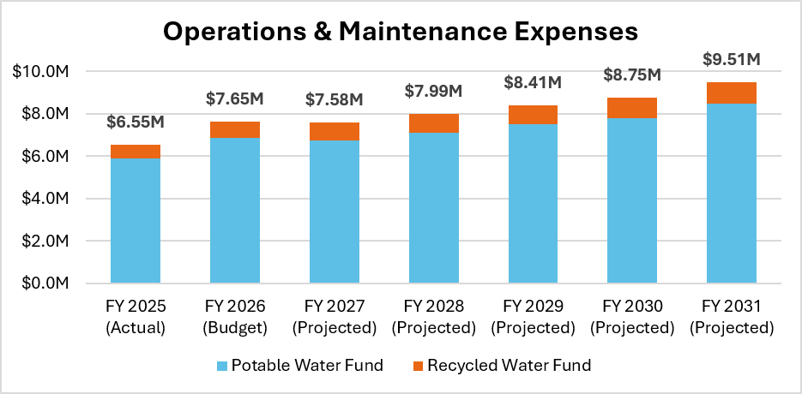
Key Assumptions: Operations & Maintenance Expenses
O&M expenses projected to increase by 4.5% per year on average

Slide 11
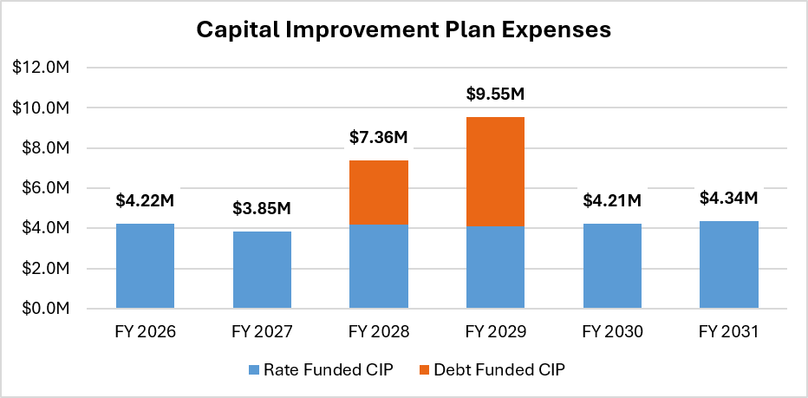
Key Assumptions: Capital Improvement Plan Expenses
$33.5M in total CIP ($5.6M per year on average)
  $8.6M in new debt funding for critical tank rehab/replacements
  All other CIP shown to be cash funded by rates

Slide 12
Reserve Policy
Reserve target (~$6 million in FY 2026):
  Operating Reserve: 90 days of operating expenses
  Rate Stabilization Reserve: 20% of volumetric water sales revenue
  Emergency Reserve: 2.5% of asset valuation
  Capital Reserve: 1 year of depreciation
  Debt Service Reserve: 100% of debt service

Slide 13
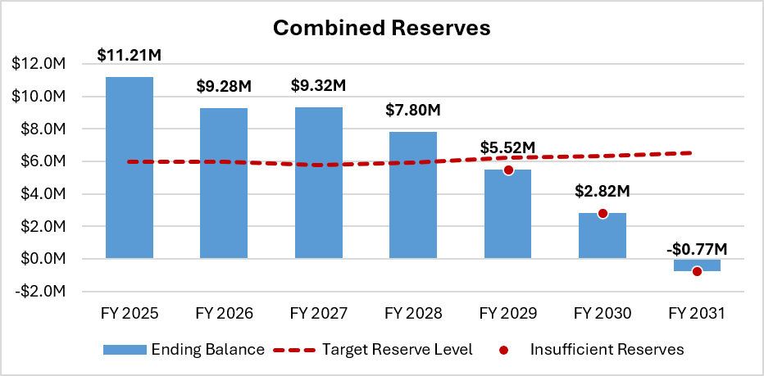
Status Quo Financial Plan:
Potable & Recycled Water Funds Combined
Fiscal Year | Effective Month | Potable Revenue Adjustment | Recycled Revenue Adjustment
FY 2027 | Jan. 2027 | 0.0% | 0.0%
FY 2028 | Jan. 2028 | 0.0% | 0.0%
FY 2029 | Jan. 2029 | 0.0% | 0.0%
FY 2030 | Jan. 2030 | 0.0% | 0.0%
FY 2031 | Jan. 2031 | 0.0% | 0.0%

Slide 14
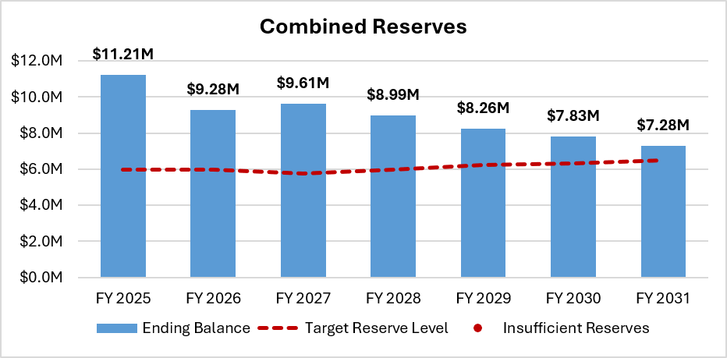
Proposed Financial Plan:
Potable & Recycled Water Funds Combined
Fiscal Year | Effective Month | Potable Revenue Adjustment | Recycled Revenue Adjustment
FY 2027 | Jan. 2027 | 6.5% | 4.0%
FY 2028 | Jan. 2028 | 6.5% | 4.0%
FY 2029 | Jan. 2029 | 6.5% | 4.0%
FY 2030 | Jan. 2030 | 6.5% | 4.0%
FY 2031 | Jan. 2031 | 6.5% | 4.0%

Slide 15
Revenue Adjustment Summary
Fiscal Year | Potable Revenue Adjustments | Recycled Revenue Adjustments
FY 2017 Adopted | 25.0% | 25.0%
FY 2018 Adopted | 15.0% | 15.0%
FY 2019 Adopted | 10.0% | 5.0%
FY 2020 Adopted | 10.0% | 3.0%
FY 2021 Adopted | 10.0% | 3.0%
FY 2022 Adopted | 5.0% | 5.0%
FY 2023 Adopted | 5.0% | 5.0%
FY 2024 Adopted | 5.0%* | 10.0%
FY 2025 Adopted | 5.0% | 10.0%
FY 2026 Adopted | 5.0% | 10.0%
FY 2027 Proposed | 6.5% | 4.0%
FY 2028 Proposed | 6.5% | 4.0%
FY 2029 Proposed | 6.5% | 4.0%
FY 2030 Proposed | 6.5% | 4.0%
FY 2031 Proposed | 6.5% | 4.0%
*Note that 3% potable revenue adjustments were implemented in FY 2024 (lower than the 5% adopted adjustment)

Slide 16
Rate Design

Slide 17
Current Rate Structure
Current Rates | Effective Jan. 2026
Monthly Basic Meter Charge
5/8-inch | $52.55
5/8-inch Rate Assistance (Residential) | $36.79
5/8-inch Fire Service (Residential/Commercial) | $13.90
3/4-inch (Multi-Residential, incl. Fire Service) | $66.44
3/4-inch | $73.46
1-inch | $115.43
1.5-inch | $229.81
2-inch | $369.92
3-inch | $767.76
4-inch | $1,357.55
6-inch | $2,706.40
Potable Volumetric Rates (per 100 gallons)
Residential Tiered Rates
Tier 1 | $0.99
Tier 2 | $1.58
Tier 3 | $2.86
Tier 4 | $3.44
Non-Residential Uniform Rates
Commercial/Industrial/Institutional (CII) | $1.61
Landscape Potable | $2.65
Recycled Volumetric Rates (per 100 gallons)
Uniform | $2.01
1) Monthly basic meter charge (by meter size)
2) Volumetric rates (per 100 gallons)
  Potable:
    Residential: 4 tiers
    Commercial/Industrial/Institutional (CII): Uniform
    Landscape potable: Uniform
  Recycled: Uniform

Slide 18
Proposed Rate Structure Changes
Proposed changes to residential tiered volumetric rates:
  Reduce from four tiers to three tiers
  Same tier allotments for single family and multi-family (per dwelling unit)
Monthly Allotment | Current (Single Family Residential) | Current (Multi-Family Residential) | Proposed (Residential)
Tier 1 | 0-3,000 gallons | 0-3,000 gallons | 0-3,000 gallons
Tier 2 | 3,001-6,000 gallons | 3,001-3,200 gallons | 3,001-6,000 gallons
Tier 3 | 6,001-7,000 gallons | 3,201-7,000 gallons | > 6,000 gallons
Tier 4 | > 7,000 gallons | > 7,000 gallons | N/A

Slide 19
Proposed Five-Year Rate Schedule
Proposed Rates | Current (Jan. 2026) | Proposed FY 2027 (Jan. 2027) | Proposed FY 2028 (Jan. 2028) | Proposed FY 2029 (Jan. 2029) | Proposed FY 2030 (Jan. 2030) | Proposed FY 2031 (Jan. 2031)
Monthly Basic Meter Charge
5/8-inch | $52.55 | $55.30 | $58.90 | $62.73 | $66.81 | $71.16
5/8-inch Rate Assistance (Residential) | $36.79 | $38.71 | $41.23 | $43.91 | $46.77 | $49.82
5/8-inch Fire Service (Residential/Commercial) | $13.90 | $10.99 | $11.71 | $12.48 | $13.30 | $14.17
3/4-inch (Multi-Residential, incl. Fire Service) | $66.44 | $66.29 | $70.60 | $75.19 | $80.08 | $85.29
3/4-inch | $73.46 | $76.15 | $81.10 | $86.38 | $92.00 | $97.98
1-inch | $115.43 | $117.86 | $125.53 | $133.69 | $142.38 | $151.64
1.5-inch | $229.81 | $222.11 | $236.55 | $251.93 | $268.31 | $285.76
2-inch | $369.92 | $347.22 | $369.79 | $393.83 | $419.43 | $446.70
3-inch | $767.76 | $743.41 | $791.74 | $843.21 | $898.02 | $956.40
4-inch | $1,357.55 | $1,327.25 | $1,413.53 | $1,505.41 | $1,603.27 | $1,707.49
6-inch | $2,706.40 | $2,724.32 | $2,901.41 | $3,090.01 | $3,290.87 | $3,504.78
Potable Volumetric Rates (per 100 gallons)
Residential Tiered Rates
Tier 1 | $0.99 | $0.97 | $1.04 | $1.11 | $1.19 | $1.27
Tier 2 | $1.58 | $2.49 | $2.66 | $2.84 | $3.03 | $3.23
Tier 3 | $2.86 | $3.37 | $3.59 | $3.83 | $4.08 | $4.35
Tier 4 | $3.44 | N/A | N/A | N/A | N/A | N/A
Non-Residential Uniform Rates
Commercial/Industrial/Institutional (CII) | $1.61 | $1.71 | $1.83 | $1.95 | $2.08 | $2.22
Landscape Potable | $2.65 | $2.31 | $2.47 | $2.64 | $2.82 | $3.01
Recycled Volumetric Rates (per 100 gallons)
Uniform | $2.01 | $2.11 | $2.19 | $2.27 | $2.35 | $2.44
Note: All Rate Assistance (Residential) and Qualifying Medical Needs (Residential) water use is proposed to be charged at the Residential Tier 1 rate; note that Qualifying Medical Needs (Residential) water use is currently charged at the Residential Tier 2 rate.

Slide 20
Monthly Bill Impacts in First Year:
Single Family Residential
Water Use Level | Monthly Water Use (gallons) | Current Monthly Bill | Proposed Monthly Bill (Jan. 2027) | Difference ($) | Difference (%)
Very Low (10th percentile) | 1,300 | $65.42 | $67.91 | $2.49 | 3.8%
Low (25th percentile) | 2,300 | $75.32 | $77.61 | $2.29 | 3.0%
Median | 3,600 | $91.73 | $99.34 | $7.61 | 8.3%
High (75th percentile) | 5,600 | $123.33 | $149.14 | $25.81 | 20.9%
Very High (90th percentile) | 8,800 | $220.17 | $253.46 | $33.29 | 15.1%
Note: Monthly bills are based on a 5/8-inch meter (most common meter size for single family residential).

Slide 21
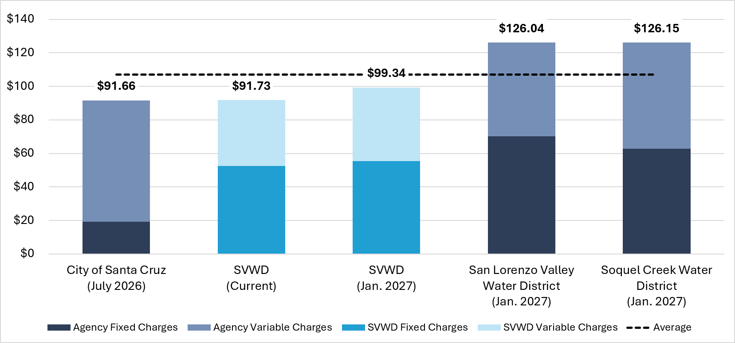
Single Family Residential Monthly Bill Comparison
Note: Monthly bills are based on a 5/8-inch meter (most common meter size for single family residential) and 3,600 gallons per month (median water use for single family residential).

Slide 22
Monthly Bill Impacts in First Year:
Multi-Family Residential
Water Use Level | Monthly Water Use (gallons) | Current Monthly Bill | Proposed Monthly Bill (Jan. 2027) | Difference ($) | Difference (%)
Very Low (10th percentile) | 6,500 | $116.90 | $118.35 | $1.45 | 1.2%
Low (25th percentile) | 9,500 | $146.60 | $147.45 | $0.85 | 0.6%
Median | 14,500 | $196.10 | $195.95 | ($0.15) | -0.1%
High (75th percentile) | 18,000 | $274.05 | $275.50 | $1.45 | 0.5%
Very High (90th percentile) | 24,500 | $459.95 | $437.35 | ($22.60) | -4.9%
Note: Monthly bills are based on a 5/8-inch meter (most common meter size for multi-family residential) and 5 dwelling units (average # of dwelling units per multi-family connection).

Slide 23
Monthly Bill Impacts in First Year:
Commercial/Industrial/Institutional
Water Use Level | Monthly Water Use (gallons) | Current Monthly Bill | Proposed Monthly Bill (Jan. 2027) | Difference ($) | Difference (%)
Very Low (10th percentile) | 300 | $57.38 | $60.43 | $3.05 | 5.3%
Low (25th percentile) | 1,700 | $79.92 | $84.37 | $4.45 | 5.6%
Median | 5,800 | $145.93 | $154.48 | $8.55 | 5.9%
High (75th percentile) | 18,900 | $356.84 | $378.49 | $21.65 | 6.1%
Very High (90th percentile) | 61,700 | $1,045.92 | $1,110.37 | $64.45 | 6.2%
Note: Monthly bills are based on a 5/8-inch meter (most common meter size for commercial/industrial/institutional).

Slide 24
Monthly Bill Impacts in First Year:
Landscape Potable
Water Use Level | Monthly Water Use (100 gallons) | Current Monthly Bill | Proposed Monthly Bill (Jan. 2027) | Difference ($) | Difference (%)
Very Low (10th percentile) | 0 | $52.55 | $55.30 | $2.75 | 5.2%
Low (25th percentile) | 0 | $52.55 | $55.30 | $2.75 | 5.2%
Median | 3,000 | $132.05 | $124.60 | ($7.45) | -5.6%
High (75th percentile) | 16,600 | $492.45 | $438.76 | ($53.69) | -10.9%
Very High (90th percentile) | 45,400 | $1,255.65 | $1,104.04 | ($151.61) | -12.1%
Note: Monthly bills are based on a 5/8-inch meter (most common meter size for landscape potable).

Slide 25
Monthly Bill Impacts in First Year:
Landscape Recycled
Water Use Level | Monthly Water Use (100 gallons) | Current Monthly Bill | Proposed Monthly Bill (Jan. 2027) | Difference ($) | Difference (%)
Very Low (10th percentile) | 0 | $52.55 | $55.30 | $2.75 | 5.2%
Low (25th percentile) | 100 | $54.56 | $57.41 | $2.85 | 5.2%
Median | 6,000 | $173.15 | $181.90 | $8.75 | 5.1%
High (75th percentile) | 39,100 | $838.46 | $880.31 | $41.85 | 5.0%
Very High (90th percentile) | 142,300 | $2,912.78 | $3,057.83 | $145.05 | 5.0%
Note: Monthly bills are based on a 5/8-inch meter (most common meter size for landscape recycled).

Slide 26
Monthly Bill Impacts over Next Five Years:
All Customer Class
Customer Class | Median Monthly Water Use (gallons) | Current Monthly Bill | Proposed Monthly Bill (Jan. 2027) | Proposed Monthly Bill (Jan. 2028) | Proposed Monthly Bill (Jan. 2029) | Proposed Monthly Bill (Jan. 2030) | Proposed Monthly Bill (Jan. 2031)
Single Family Residential | 3,600 | $91.73 | $99.34 | $106.06 | $113.07 | $120.69 | $128.64
Multi-Family Residential | 14,500 | $196.10 | $195.95 | $209.70 | $223.68 | $239.36 | $255.31
Commercial/Indu-strial/Institutional | 5,800 | $145.93 | $154.48 | $165.04 | $175.83 | $187.45 | $199.92
Landscape Potable | 3,000 | $132.05 | $124.60 | $133.00 | $141.93 | $151.41 | $161.46
Landscape Recycled | 6,000 | $173.15 | $181.90 | $190.30 | $198.93 | $207.81 | $217.56
Note: Monthly bills are based on a 5/8-inch meter (most common meter size for landscape recycled).
Note: Monthly bills are based on a 5/8-inch meter (most common meter size) and median monthly water use for each customer class. Multi-family residential bills are based on 5 dwelling units (average # of dwelling units per multi-family connection).

Slide 27
Discussion & Next Steps

Slide 28
Next Steps
TODAY:
  Receive & file rate study report
  Determine whether to authorize staff to develop and mail out public hearing notices
July 10, 2026: Deadline to mail out public hearing notices to all customers
Sep. 10, 2026: Proposition 218 Public Hearing (special Board Meeting)
Jan. 1, 2027: New rates effective

Slide 29
Sanjay Gaur
Founder / President
sgaur@water-economics.com

Slide 30
Back-up Slides

Slide 31
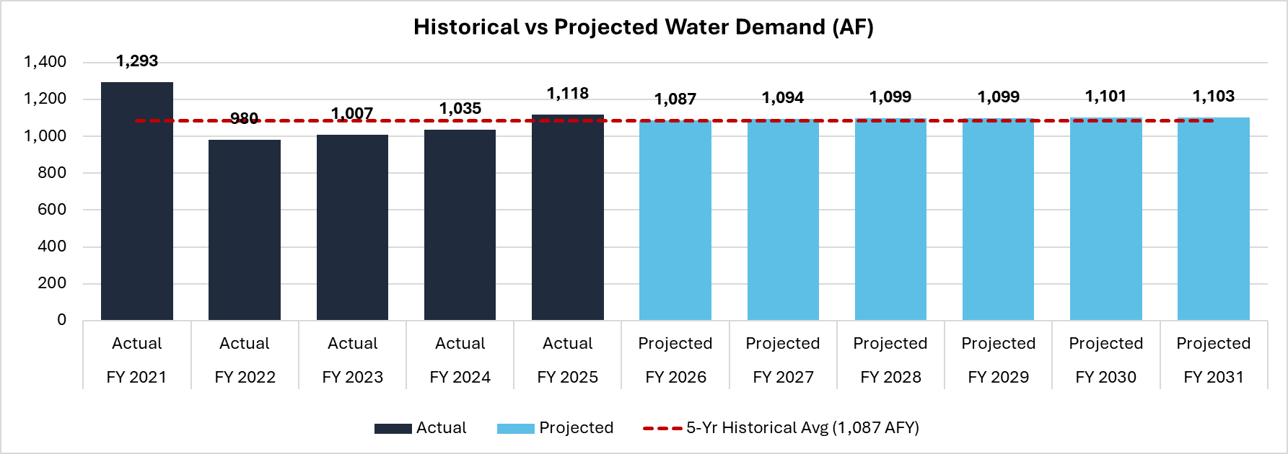
Key Financial Plan Assumptions: Water Demand
FY 2026 projected water demand set equal to 5-year historical average
Projected increases in FY 2027-FY 2031 due to new development*
*Conservatively assuming 12 new connections per year on average based on planned construction

Slide 32
Key Financial Plan Assumptions: CIP
Project costs in red are assumed to be debt financed
All other project costs are “levelized” on an annual basis and assumed to be cash funded by rates/reserves
CIP Project Costs (Current Dollars*) | FY 2026 | FY 2027 | FY 2028 | FY 2029 | FY 2030 | FY 2031 | Total
Potable Water Fund
Bethany Tank Rehabilitation | $481,387 |  | $3,000,000 | $3,000,000 |  |  | $6,481,387
Mt. Roberta Tank Replacement |  |  | $100,000 | $1,000,000 |  |  | $1,100,000
Villa Fontenay Tank Replacement |  |  | $100,000 | $1,000,000 |  |  | $1,100,000
All Other Potable CIP Projects (Levelized) | $3,633,669 | $3,633,669 | $3,633,669 | $3,633,669 | $3,633,669 | $3,633,669 | $21,802,013
Subtotal | $4,115,055 | $3,633,669 | $6,833,669 | $8,633,669 | $3,633,669 | $3,633,669 | $30,483,400
Recycled Water Fund
All Recycled Water CIP Projects (Levelized) | $107,500 | $107,500 | $107,500 | $107,500 | $107,500 | $107,500 | $645,000
Subtotal | $107,500 | $107,500 | $107,500 | $107,500 | $107,500 | $107,500 | $645,000
Total | $4,222,555 | $3,741,169 | $6,941,169 | $8,741,169 | $3,741,169 | $3,741,169 | $31,128,400
*Costs shown are in current dollars and do not yet include 3% annual inflationary adjustments

Slide 33
Exhaustion of Remedies (Government Code Section 53759.1)
Provides ratepayers 45 days to review proposed rate increases & submit a written objection that specifies grounds for alleged noncompliance
Agency must respond to and consider any written objections
A legal challenge to the proposed rates is prohibited unless that party submitted a written objection

