Slide 1


Scotts Valley Water District
Board of Directors
June 11, 2026
2025 Urban Water Management Plan
Status and Overview

Slide 2
Purpose and Outcome Today
Overview
2025 Urban Water Management Plan
Updates
Key Findings
Preview
Upcoming draft and adoption schedule

Slide 3
UWMP Overview
Mandated by CA Water Code to be submitted to DWR every 5 years. Due July 1, 2026
Evaluates reliability under drought conditions
LAFCO & County planners rely on the UWMP for development project approvals
Provides water supply and demand projections over a 25-year horizon
Maintains Eligibility for certain State loan/grants
DWR Guidebook has standard reporting tables and requirements

Slide 4
Schedule for Preparation and Adoption
Date | Milestone / Action
Dec 2025 | Contract Award
Feb 3, 2026 | 60-day agency letters
Feb 23 & Mar 12, 2026 | Presentations: Population & Demand
Apr 27 & May 14, 2026 | Presentations: WSCP Updates and Adoption
May 27, 2026 | Presentation: UWMP Overview
May 28, 2026 | UWMP Public Draft Released
May 28 & June 4, 2026 | Newspaper notices for public hearing
June 11, 2026 | Board: Public hearing and UWMP Adoption (today)
By July 1, 2026 | Submittal to DWR

Slide 5
UWMP Chapters
2025 UWMP Chapters | Title | 2020 UWMP Chapter Reference
Chapter 1 | Introduction and Lay Description | Ch. 1
Chapter 2 | Plan Preparation and Adoption | Ch. 2
Chapter 3 | Service Area Description | Ch. 3
Chapter 4 | Water Use Characterization | Ch. 4
Chapter 5 | SBX7-7 Baseline, 2020 Target, and 2025 Reporting | Ch. 6
Chapter 6 | Water Supply Characterization | Ch. 8, Ch. 9
Chapter 7 | Water Service Reliability & Drought Risk Assessment | Ch. 11
Chapter 8 | Water Shortage Contingency Plan | Ch. 13
Chapter 9 | Demand Management Measures | Ch. 14

Slide 6
What’s New Since 2020
Stand Alone UWMP (SVWD only)
Revised population and demand projections
Updated Water Shortage Contingency Plan (May 14, 2026)
SMGB Groundwater Sustainability Plan (adopted 2022)
Regional Intertie (high-level narrative)
Reporting updates from new regulations:
  Water Loss Standards (SB 555)
  Water Use Objectives (SB 606)

Slide 7
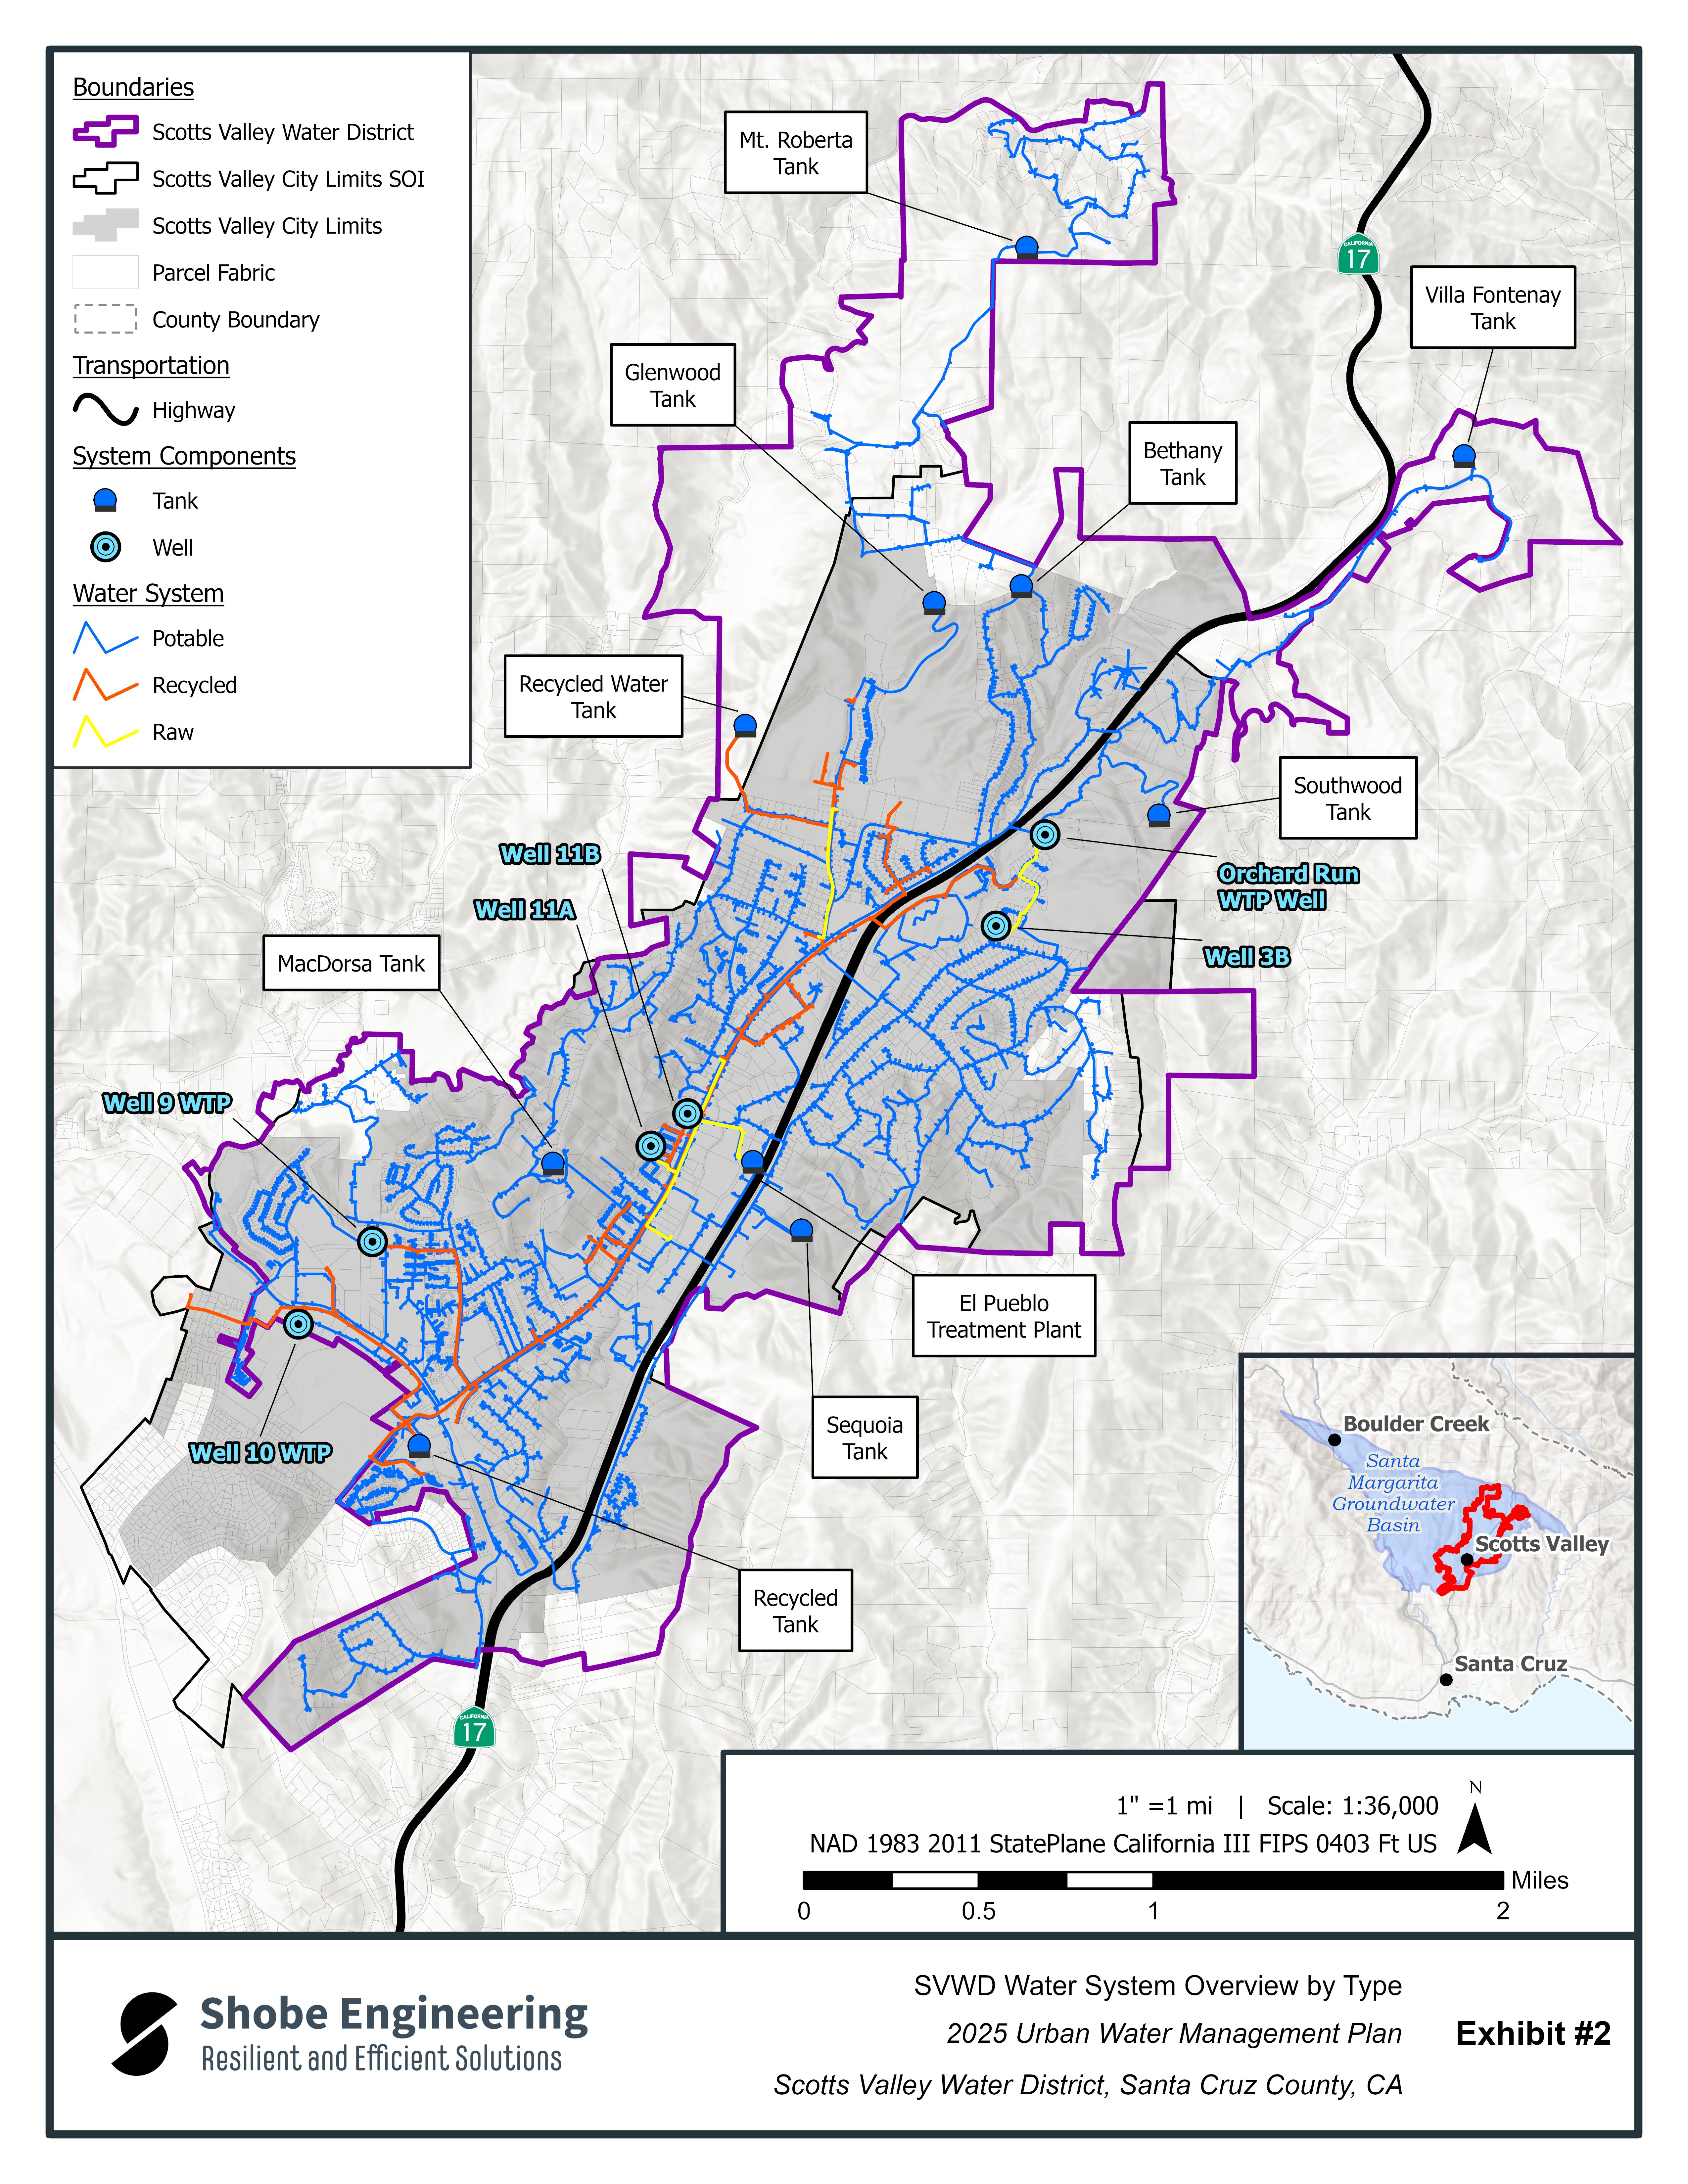
System Overview Map
Potable (3,941 Customers)
6 Groundwater wells / 4 WTPs
8 Storage tanks / 11 Zones
Interties - SLVWD and (coming) Santa Cruz
Recycled (82 customers)
City WRF (Title 22) supply
9-miles of Purple pipe network
SVWD Boundary vs City Boundary (70% overlap)
Sphere of Influence – LAFCO Updated 4/5/2023
Notes:
Scotts Valley Drive

Slide 8
Growth and Demand Summary
Growth driven by City General Plan and RHNA
Population from 9,924 to 13,548 by 2050
  Used 2.50 PPH (per the City General Plan)
  In comparison the 2020 UWMP had 13,082 by 2045
Demand accounts for water savings
  Indoor/outdoor water usage factors
  Water Use Objectives
  Existing vs. New construction
Demand estimates increase from 1,046 AF to 1,193 AF by 2050
  In comparison to 2020 UWMP: 1,144 AF by 2045
Notes:
Brief overview on historic growth and demand

Slide 9
Population & Demand Projections
*Presented to SVWD Board (March 12, 2026)
Population Estimates (DWR Table 3-1R)
Population Served | 2025 | 2030 | 2035 | 2040 | 2045 | 2050 (opt)
 | 9,924 | 10,676 | 11,419 | 12,162 | 12,905 | 13,548
Projected Water Demand – Acre-feet (DWR Table 4-2R)
Use Type | 2025 | 2030 | 2035 | 2040 | 2045 | 2050
Single Family | 568 | 589 | 610 | 632 | 653 | 671
Multi-Family | 59 | 59 | 59 | 59 | 59 | 59
CII | 252 | 263 | 274 | 285 | 296 | 305
Landscape | 65 | 65 | 65 | 65 | 65 | 65
Distribution System Water Loss | 98 | 95 | 93 | 90 | 88 | 86
Bulk Potable Stations | 5 | 5 | 5 | 6 | 6 | 6
Total Potable | 1,047 | 1,076 | 1,106 | 1,137 | 1,167 | 1,192
Notes:
Based on:
Service connections
Observed usage – consistent / stable patterns since 2017
Conservative assumptions: No future conservation reductions assumed

Slide 10
Water Supply Overview
Groundwater System
  SMGB Supply (GSP)
  SVWD Baseline Pumping 1,300 AFY (Butano & Lompico aquifers)
  Projected to be sustainable under future scenarios
  While groundwater is susceptible to climatic variability, reliability is supported through by active management under the GSP and implementation of the WSCP
Recycled Water (City WRF)
  Ongoing use and viable for future growth needs
Future Project – Regional Intertie

Slide 11
Water Loss & State Regulations
SWRCB has established
  Water Loss Standard (SB 555) – water audits, water losses
  Water Use Objectives (SB 606) – indoor 48 gpcd
  Not enforced through UWMP, but progress is reported
  Enforcement begins 2028, compliance tracking 2025-2027
SVWD
  State assigned Real Water Loss standard for each supplier
  SVWD baseline 15.6 gallons per SC per day (gpscd)
  State Standard assigned 15.6 gpscd
  Most recent audit: 14.0 gpscd (varies year to year)
  Evaluating water loss reporting and future savings

Slide 12
Key Takeaways
The 2025 UWMP confirms adequate supplies
Growth and demand assumptions are conservative
Groundwater remains a reliable supply
Plan is consistent with State requirements

Slide 13
Next Steps
Public draft May 28
Public hearing June 11 (Board meeting)
Adoption by Board resolution
Submit to DWR by July 1

Slide 14
Thank You

